Slide 1
Doctor In Rural Areas
Course Name:
Human Computer Interaction
Course Code:
CSC-3092
Course Instructor:
Ms.Narmeen Bhawaney

Slide 2
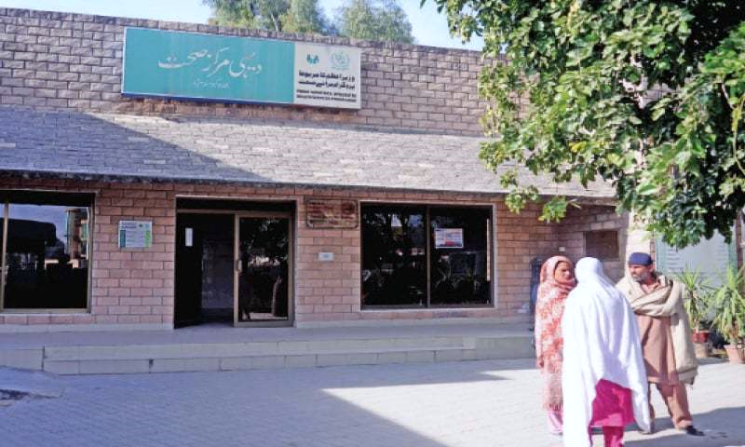
PROBLEM STATEMENTS
Its hard for only one doctor to handle so many patients in rural areas. Mostly people don’t know how to reach out to the doctors, some lives very far away from the hospital & its not convenient for them to visit doctor very frequently & some has no access to the hospital or doctor. Although health is priceless but healthcare cost money. In 2011, more hospitals have closed than opened. Hospitals in rural areas in particular face several financial challenges as well. A variety of elements contributes to these problems in rural areas, including a declining population, economics stagnation, shortages of physicians and other health care professionals, a disproportionate number of elderly, poor,& underinsured residents. There is no urgent care available on the go.

Slide 3
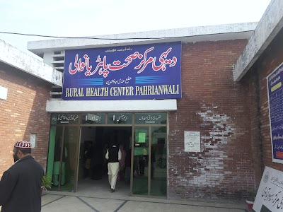
PROBLEM STATEMENTS
There ae so many problems that people & doctors face in rural areas like unavailability of some medicines, if a certain medicines is not available there are no alternative for that medicines. The biggest problem that the hospital, doctors & patients face is no past data available of the patient basically patient’s health & medication history plus prescriptions. In rural areas the foremost problem that people face is unawareness there are lack of public service messages and guidance on viral & diseases. Most of the time people don’t know about the viral & standard operating procedures in order to prevent them which cause a lot of harm & damage. The challenges people face in rural areas when it comes to healthcare are immense & blend to these problems are seem to be none.

Slide 4
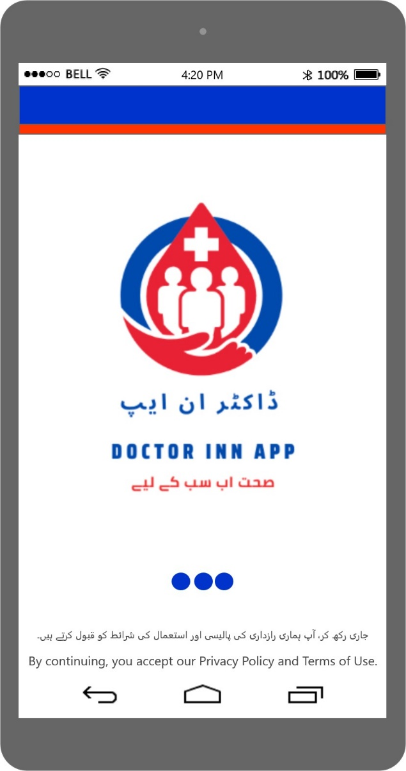
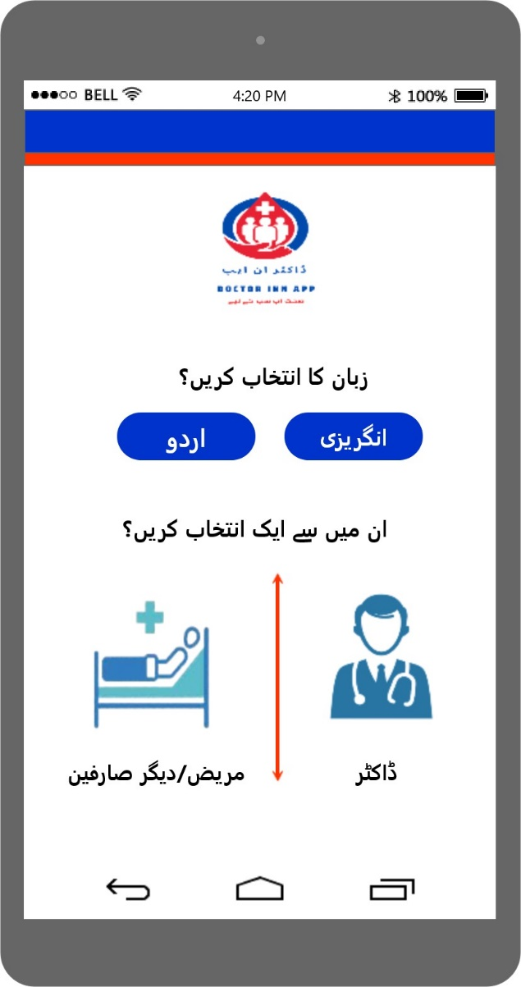
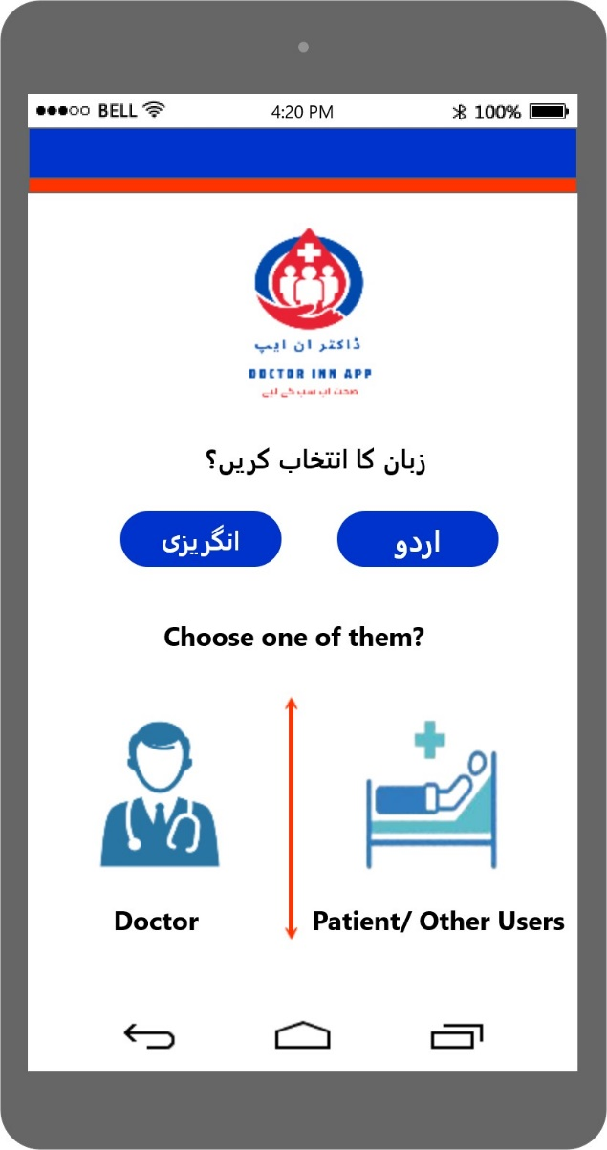
PROTOTYPE
Start Screen
Choose language screen in Urdu
Choose language screen in English

Slide 5
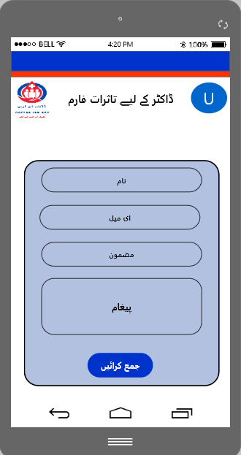
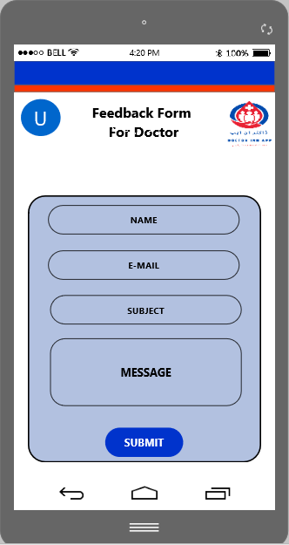
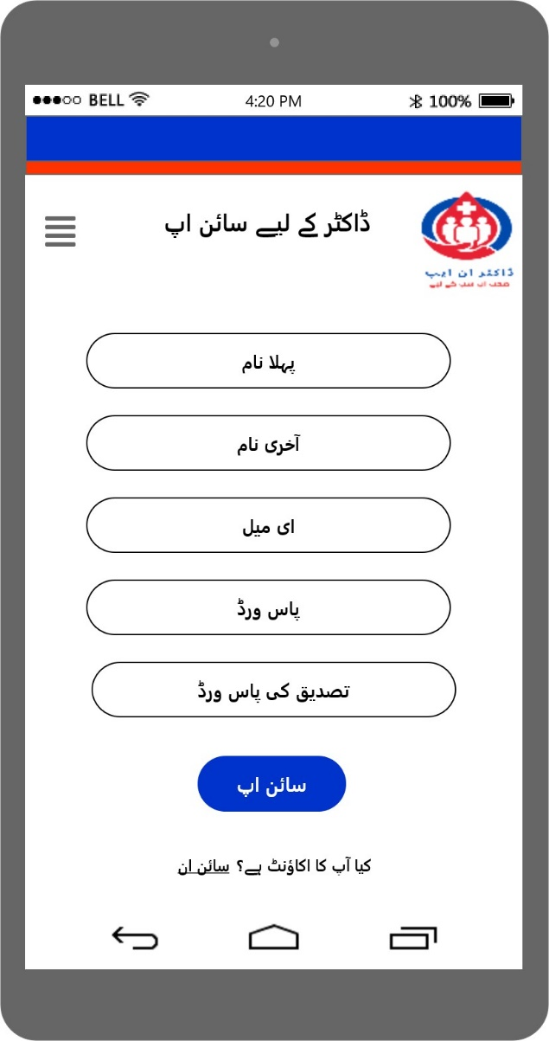
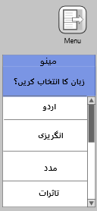
PROTOTYPE
Only Doctor can Sign Up & Sign In (Sign Up screen in Urdu)
Feedback form screen for Doctor
in Urdu
Feedback form screen for Doctor
in English

Slide 6
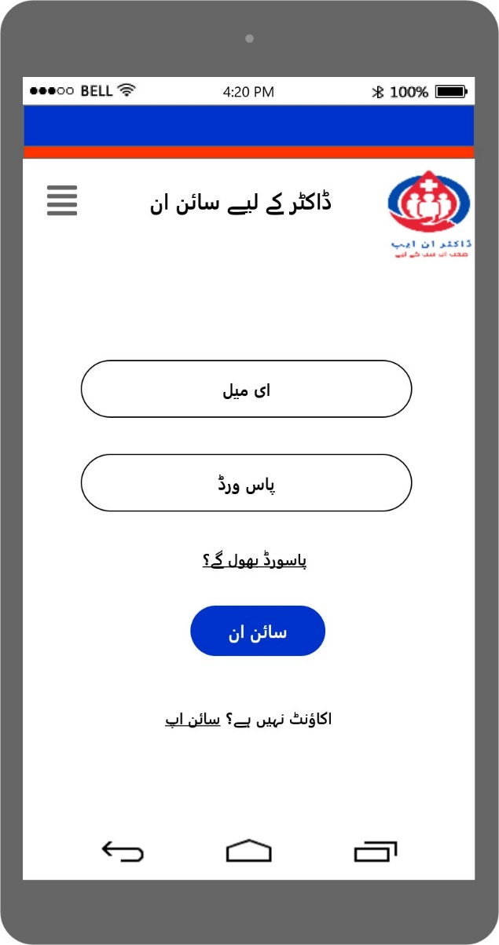
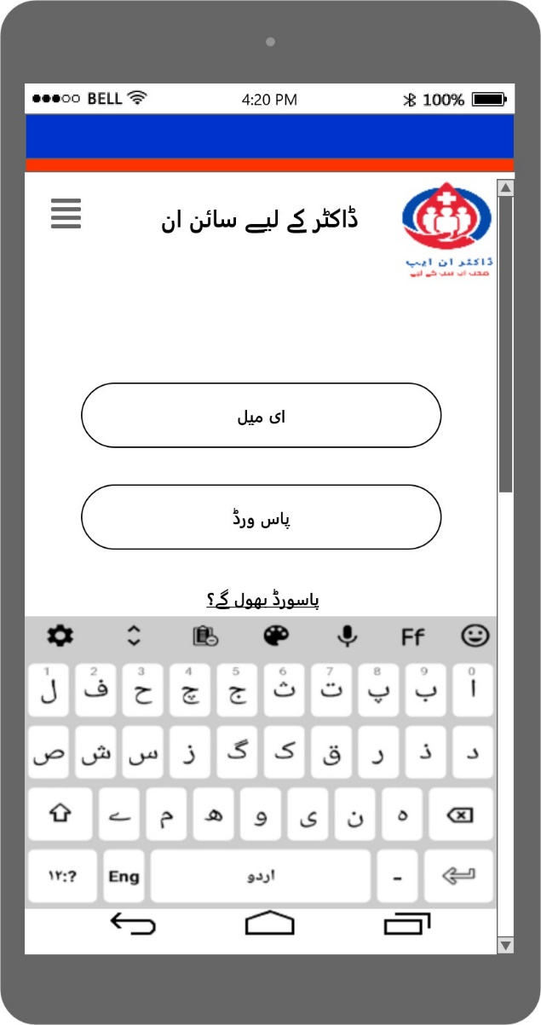
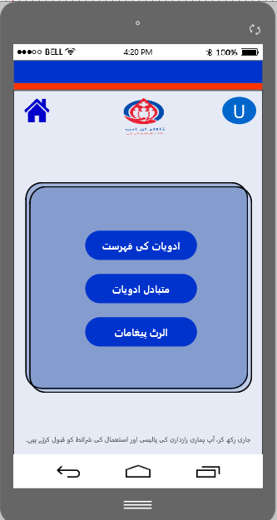
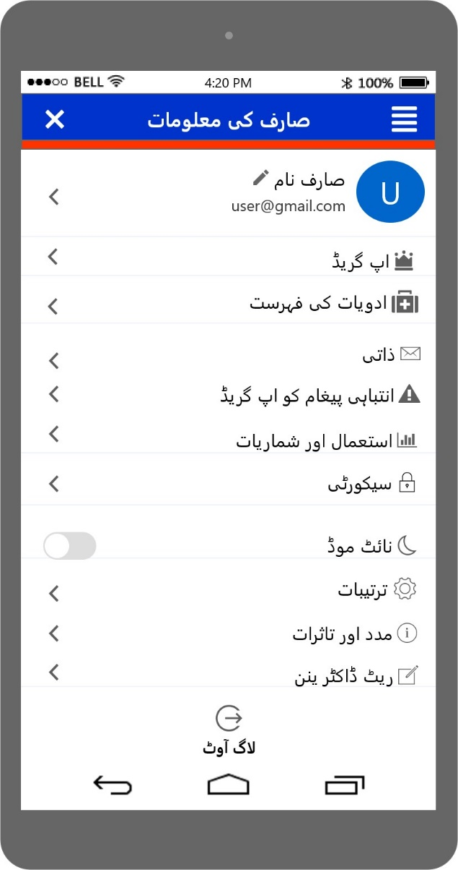
PROTOTYPE
Sign in, home & User Info screens in Urdu

Slide 7
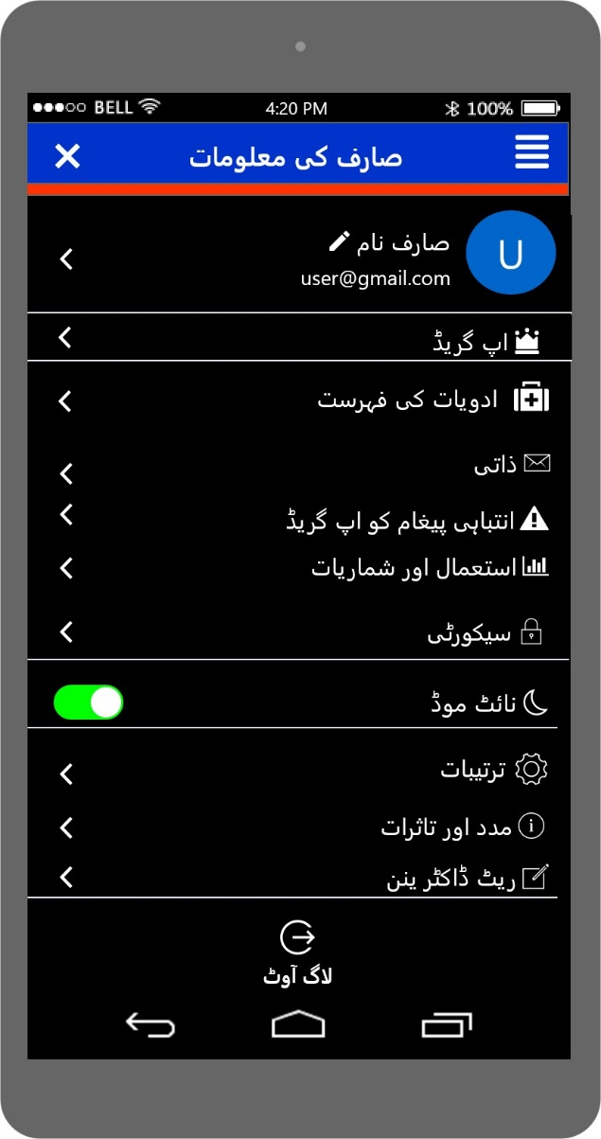
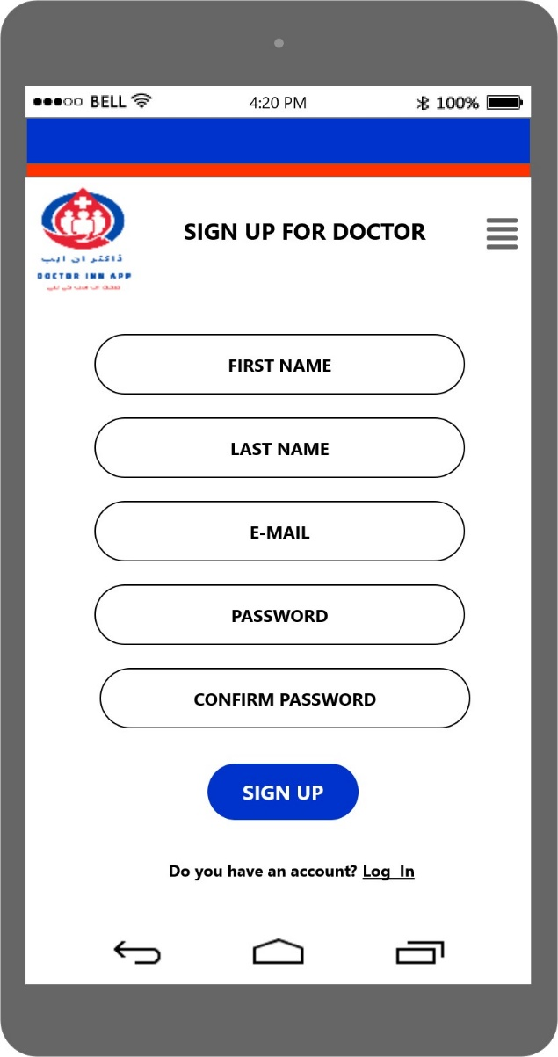
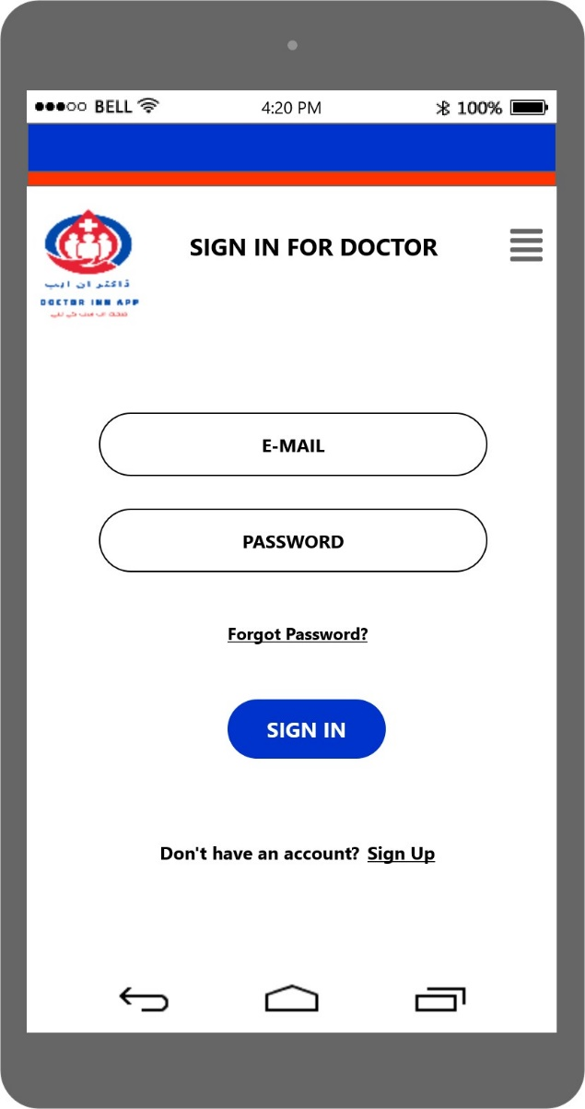
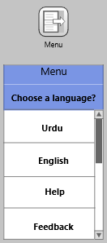
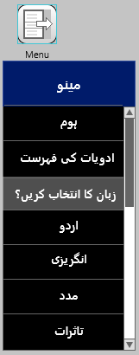
PROTOTYPE
Dark mode User Info in Urdu & Sign up & Sign in screen in English
Sign up
Screen in English

Slide 8
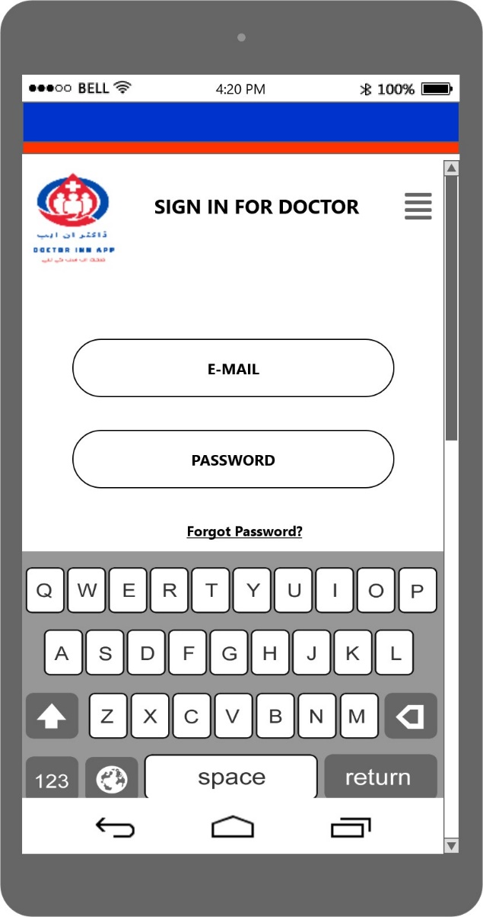
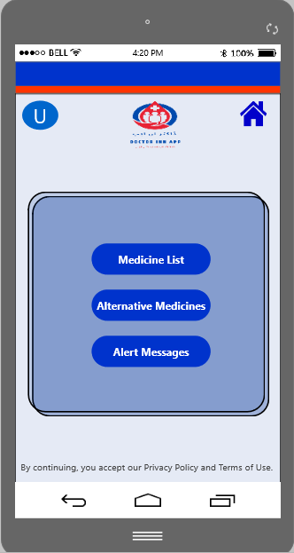
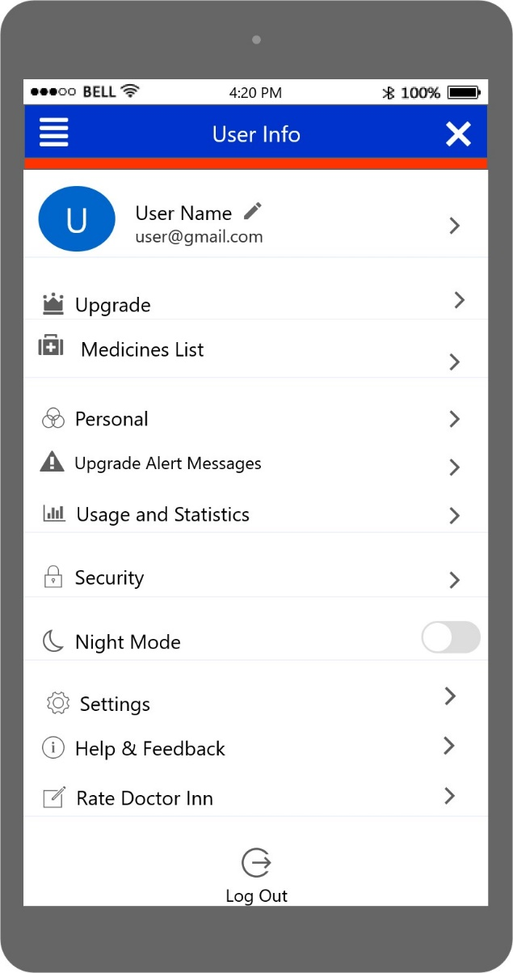
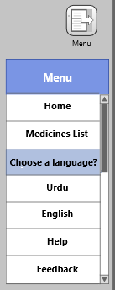
PROTOTYPE
Sign in, User Info & Home screens in English

Slide 9
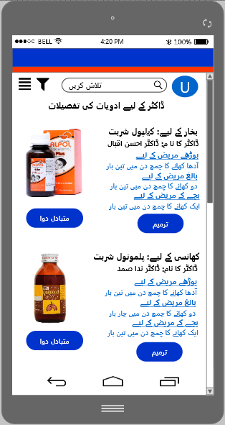
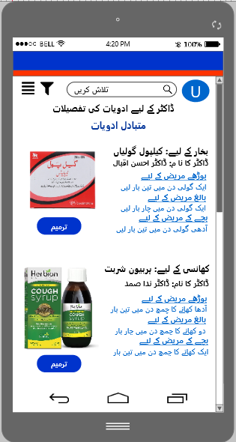
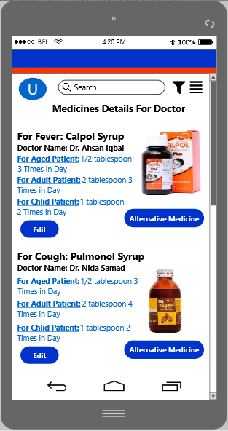
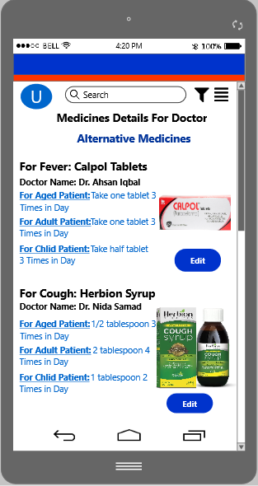
PROTOTYPE
Medicine screens for doctor
in Urdu & English (update Medicines for patient)

Slide 10
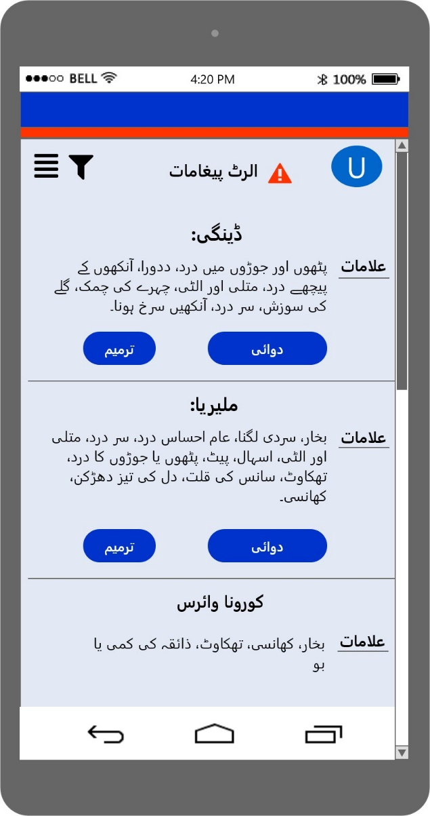
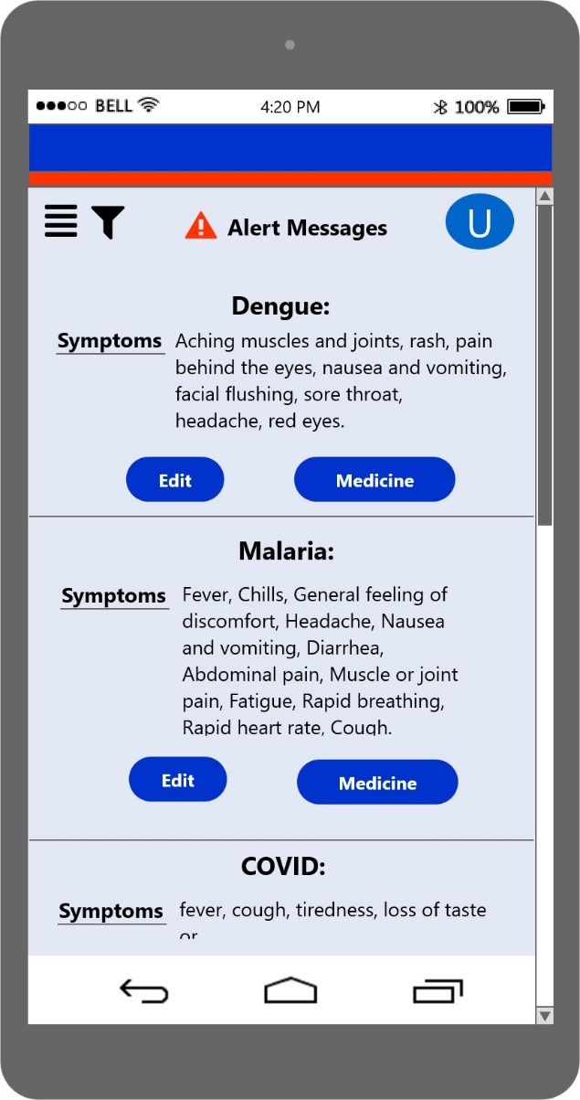
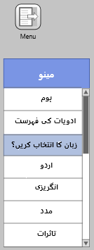
PROTOTYPE
Alert message screens for doctor in Urdu & English (update alert messages for patient)

Slide 11
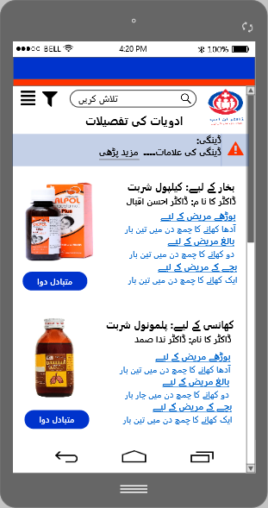
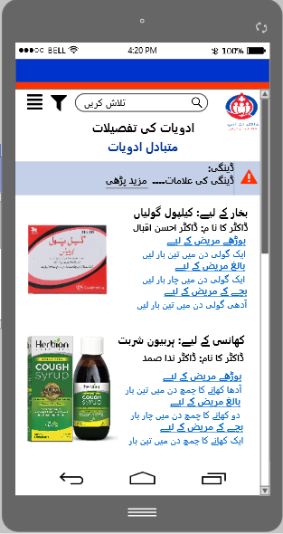
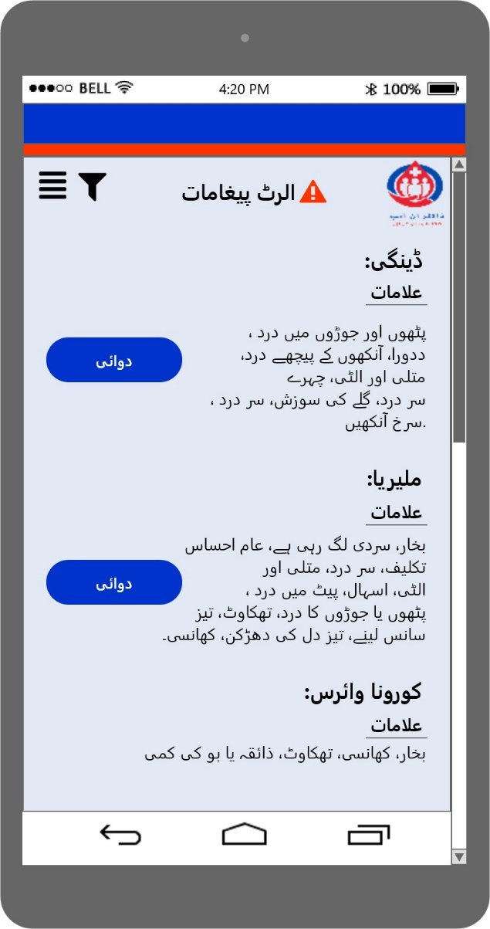
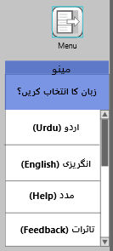
PROTOTYPE
Medicine screens for patient
in Urdu
Alert msg screen for patient in Urdu

Slide 12
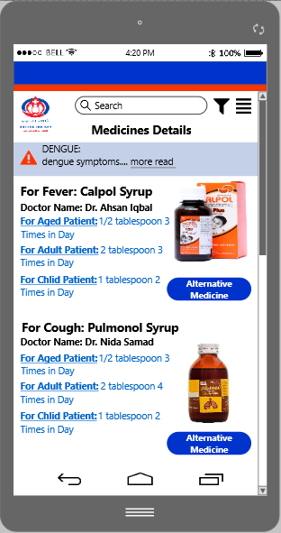
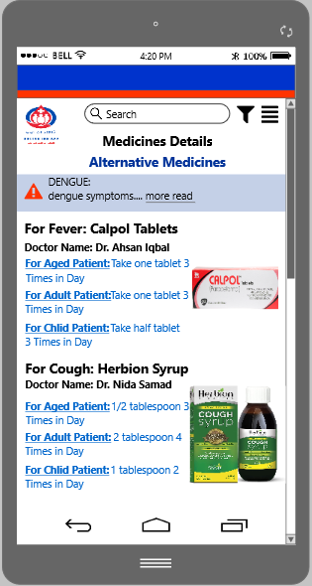
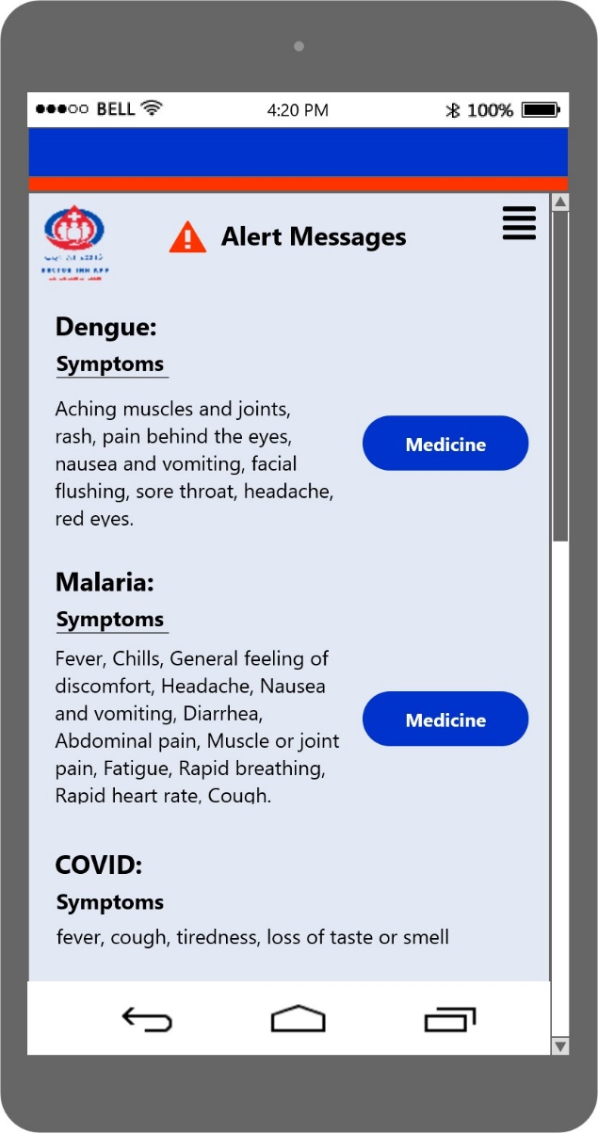
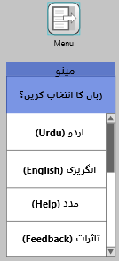
PROTOTYPE
Medicine screens for patient
in English
Alert msg screen for patient in English

Slide 13
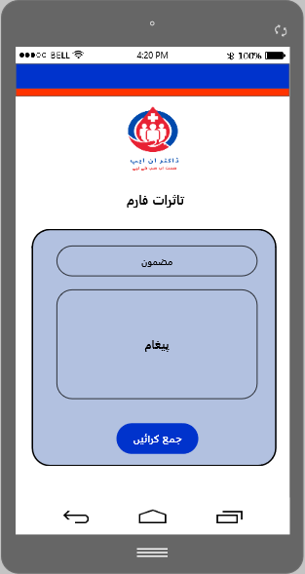
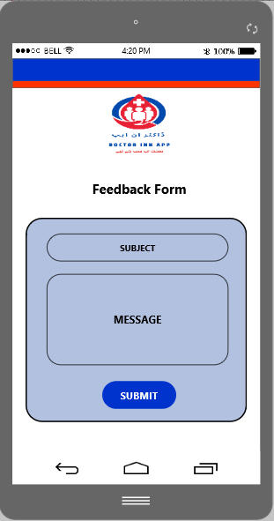
PROTOTYPE
Feedback Form screens for user/patients in Urdu & English (submit feedback)

Slide 14
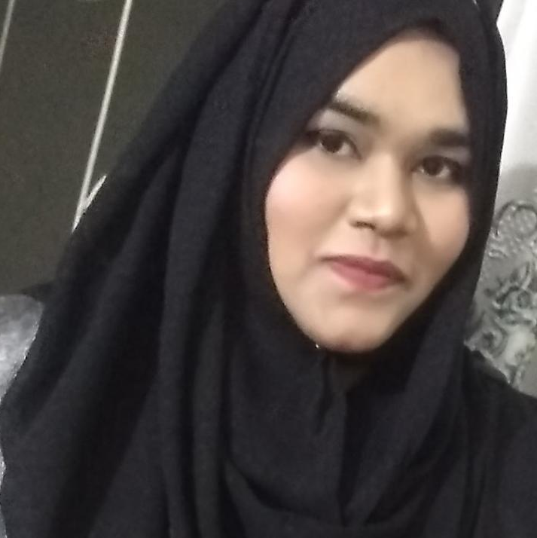
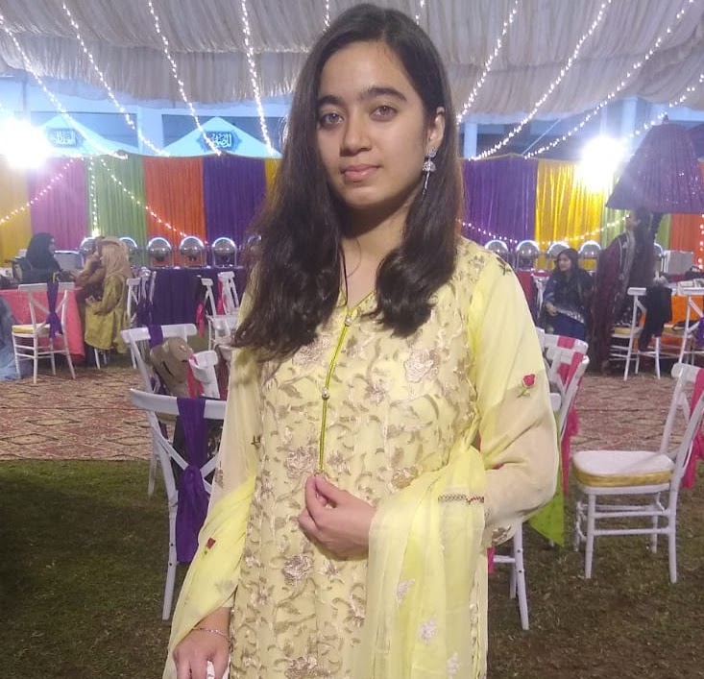
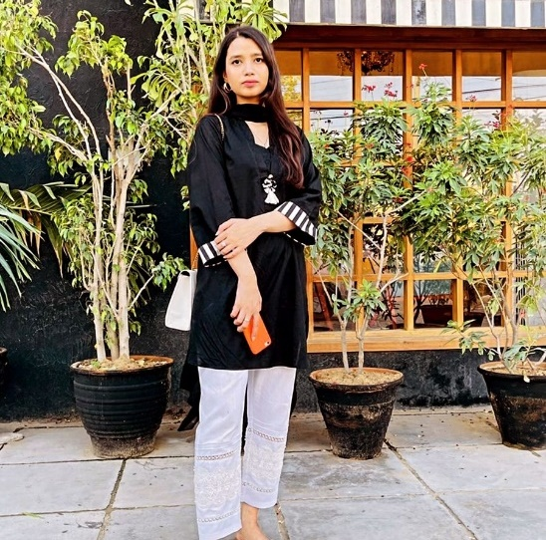
OUR TEAM MEMBERS
Hareem Imran
Insharah Riaz
Ujala Shah
juw08057
juw06692
juw07183

Slide 15
Thank You!
Email Address:
hareem.im3699@gmail.com
insharah.ir@gmail.com
ujalashahh100@gmail.com

